Slide 1
Managing Buffel Grass Developing Trust and working on other peoples country Ancient culture, modern problem
Natural Resources Alinytjara Wilurara
September 2015

Slide 2
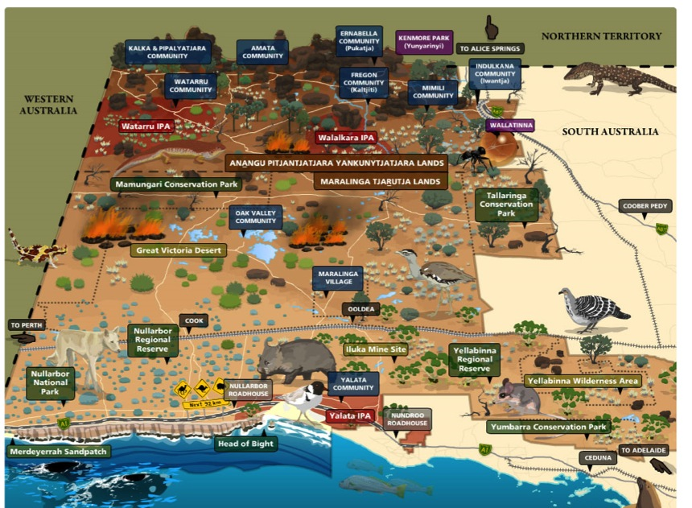
Welcome to the Alinytjara Wilurara Region

Slide 3
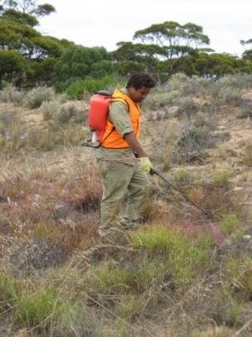
What we’ll be talking about today…
The region and its people
Managing Buffel Grass on Traditional Lands
Complexity of traditional and contemporary pastoral management

Slide 4
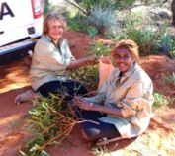
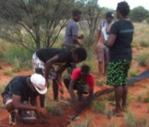
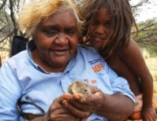
The Alinytjara Wilurara Region and its people
The AW Region covers over 250,000 km² in the north west quarter of SA stretching from the NT and WA borders south to the Great Australian Bight, ie 23% of South Australia. (In Pitjantjatjara, alinytjara means ‘north’ and wilurara ‘west’.)
Our People
population of approximately 3,250 people spread over multiple remote locations
most retain strong links to their traditional culture
largely of Pitjantjatjara, Yankunytjatjara and Ngaanyatjara descent, collectively known as Anangu
Culture is central to life and management of country

Slide 5
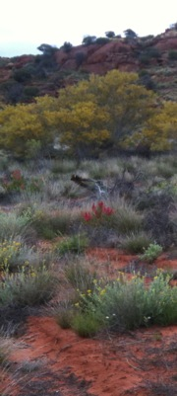
Our Challenges…
Undertaking work within the Region presents enormous challenges including:
time it takes to travel to communities within the AW Region
lack of infrastructure at community level
poor access to digital technology
a highly mobile population
a low skill base and casual work force
local cultural considerations

Slide 6
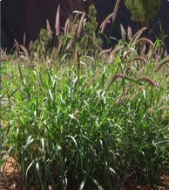
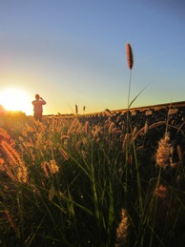
Managing Buffel… North to South
A journey through the AW NRM Region…
from the APY Lands to Maralinga from a cultural and ecological perspective
focussing on the spread of Buffel Grass
In 2014 the invasive weed Buffel Grass was declared a Weed.
Buffel Grass considered to be beyond eradication in APY Lands
Maralinga Tjarutja is the front line in the battle to control its spread further south

Slide 7
Cars, cattle and camels…
Movement of:
People
Cattle
Camels

Slide 8
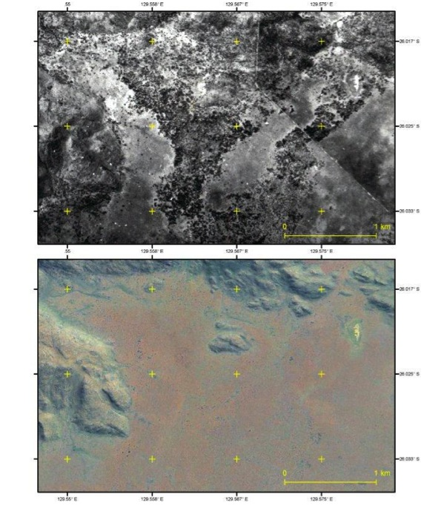
Past and Present…
Reduction of mallee woodlands
Buffel burns hotter than native grasses (e.g. spinifex)

Slide 9
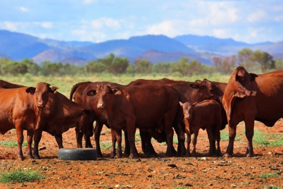
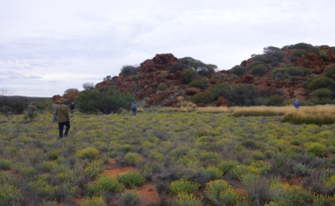
Buffel Grass in the APY Lands…
Feed for cattle versus environmental protection?

Slide 10
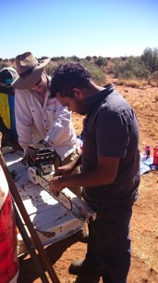
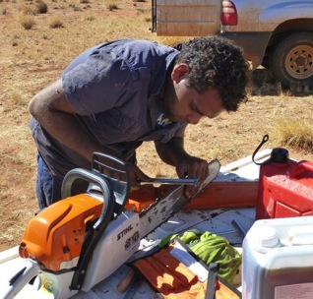
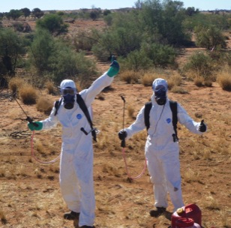
Training and Education
Awareness
Skills

Slide 11
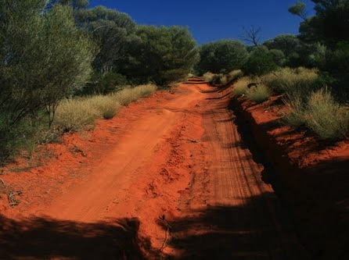
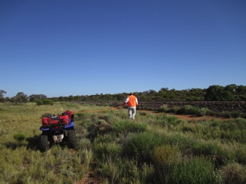
Travelling South
Monitoring and managing
tracks and trains…

Slide 12
Thank you
Alinytjara Wilurara Natural Resources Management Board

